Slide 1
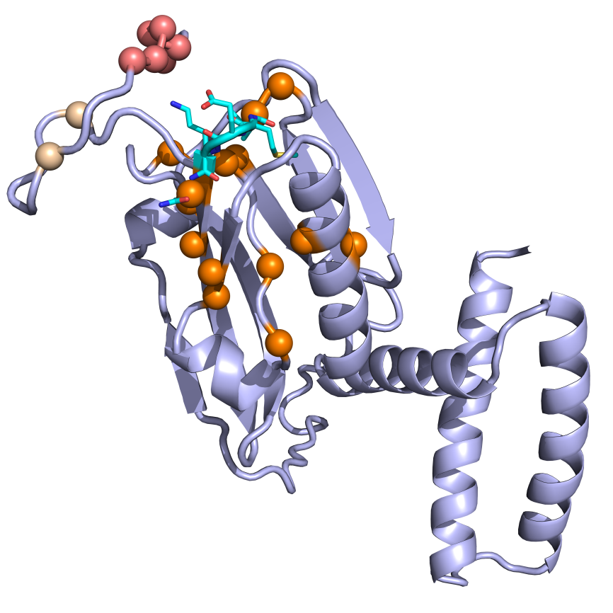
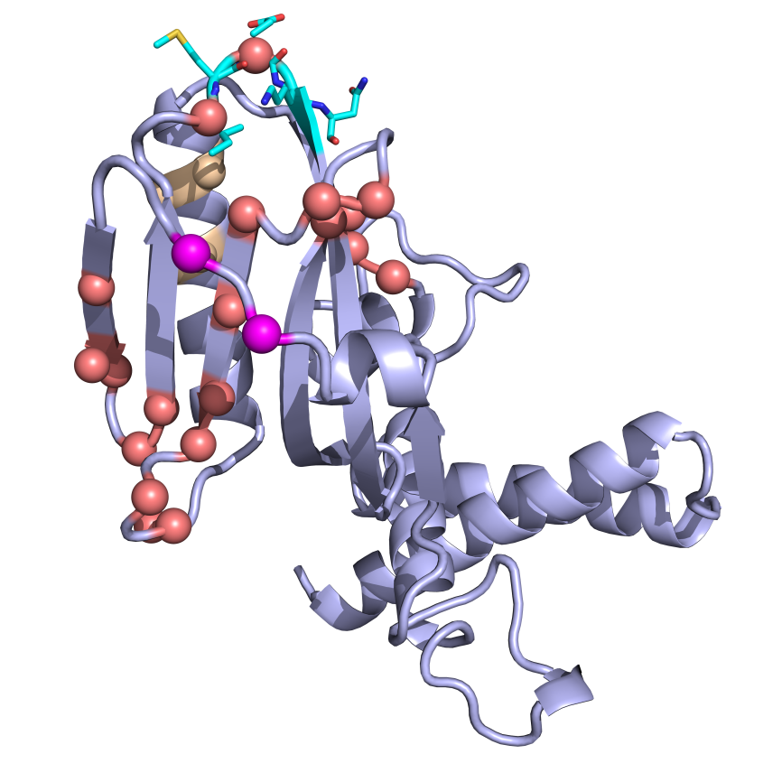
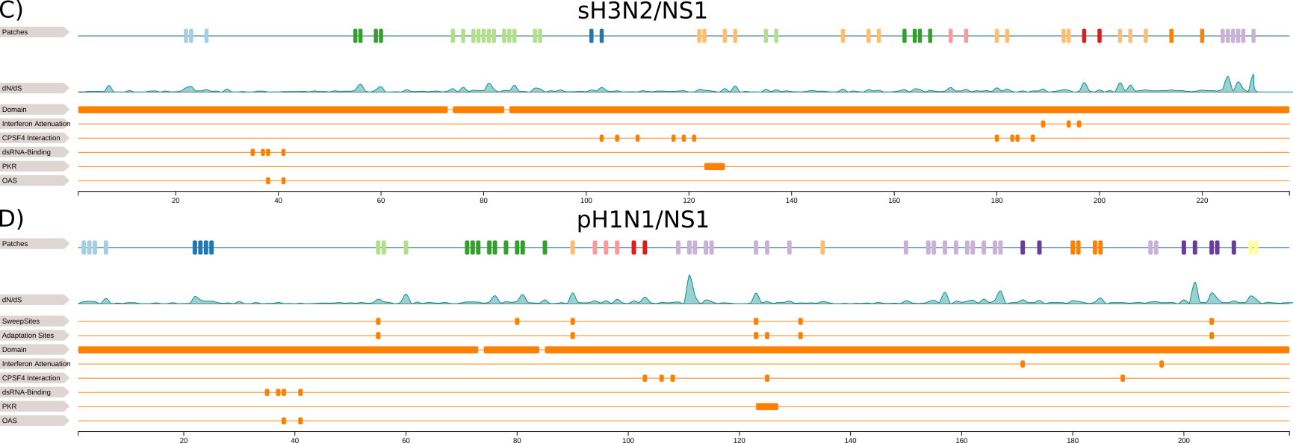
A)
P9
B)
123 – 127
PKR binding region
123 - 127
PKR binding region
P8
P8
P9
P7
P6
Notes:
sH3N2/NS1
pH1N1/NS1

